Slide 1





WEBINAR
Active Directory Delegation Attacks
| Payatu

Slide 2

Agenda
Understand the Configuration of Delegation Lab
Spin up Delegation Lab on AWS.
Understand and exploit
Unconstrained Delegation (KUD)
Constrained Delegation (KCD)
Resource Based Constrained Delegation (RBCD)

Slide 3
Key Takeaways
Have an automatically built-up Active Directory Lab
Multiple Attack Vectors from Windows and Linux
Tools and Techniques required to exploit various Delegation Scenarios

Slide 4


About the SPEAKER
Syed Modassir Ali
Associate Security Consultant, Payatu
Social Handle @gr33nm0nk2802
Security Researcher and Red Teamer
Holds CRTO | OSCP | CRTP | eCPPTv2 | CEH
Previously spoken at DEFCON, BSIDES, NULL, OWASP etc..
Interested in playing CTFs and Red Teaming exercises

Slide 5
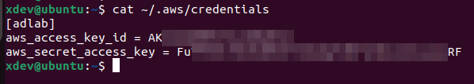
Lab Pre-Requisites
https://github.com/gr33nm0nk2802/DelegationLab
AWS account with access to create resources (VPC, Subnet, Route Tables, Security Groups, EC2)
AWS_ACCESS_KEY configured on the CLI

Slide 6
Lab Setup
Provisoning the Infrastructure.
(Can take around 8-10 minutes to have the Windows EC2 Instances to be up and running with WINRM configured)
ansible-playbook provision.yml
Destroying the Infrastructure.
ansible-playbook destroy.yml

Slide 7
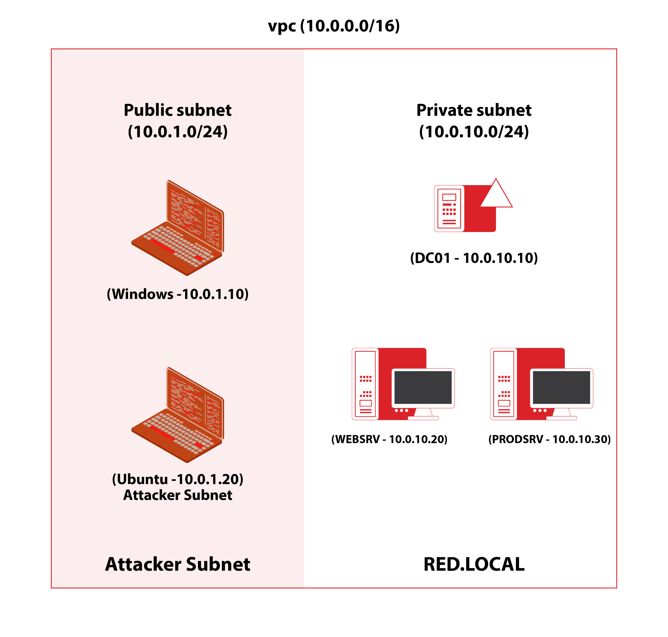
Lab Architecture

Slide 8
Lab Setup (Part -2)
Configuring the VM.
SSH onto the Ubuntu machine and use rsync too synchronize the files from our host to attacker ubuntu instance.
Run the setup script to install ansible and other dependencies on the client.
./ansible.sh
Finally deploy the playbooks to create the VMs. (This should take additional 15-20mins)
./domain-create.sh

Slide 9
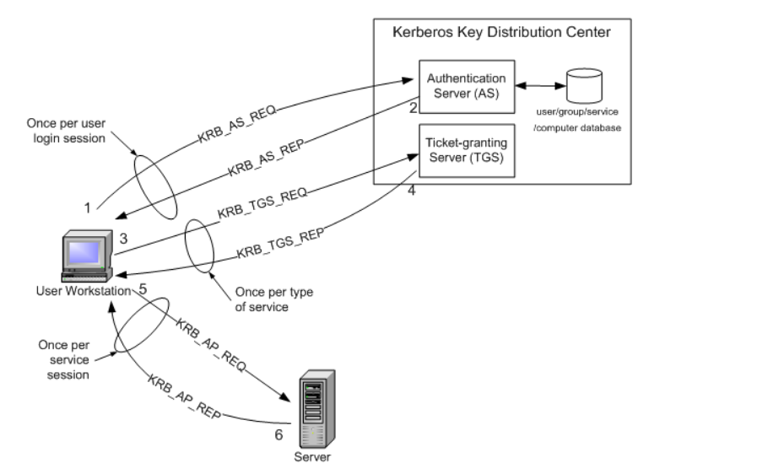
Kerberos Authentication
Intel® AMT SDK Implementation and Reference Guide

Slide 10
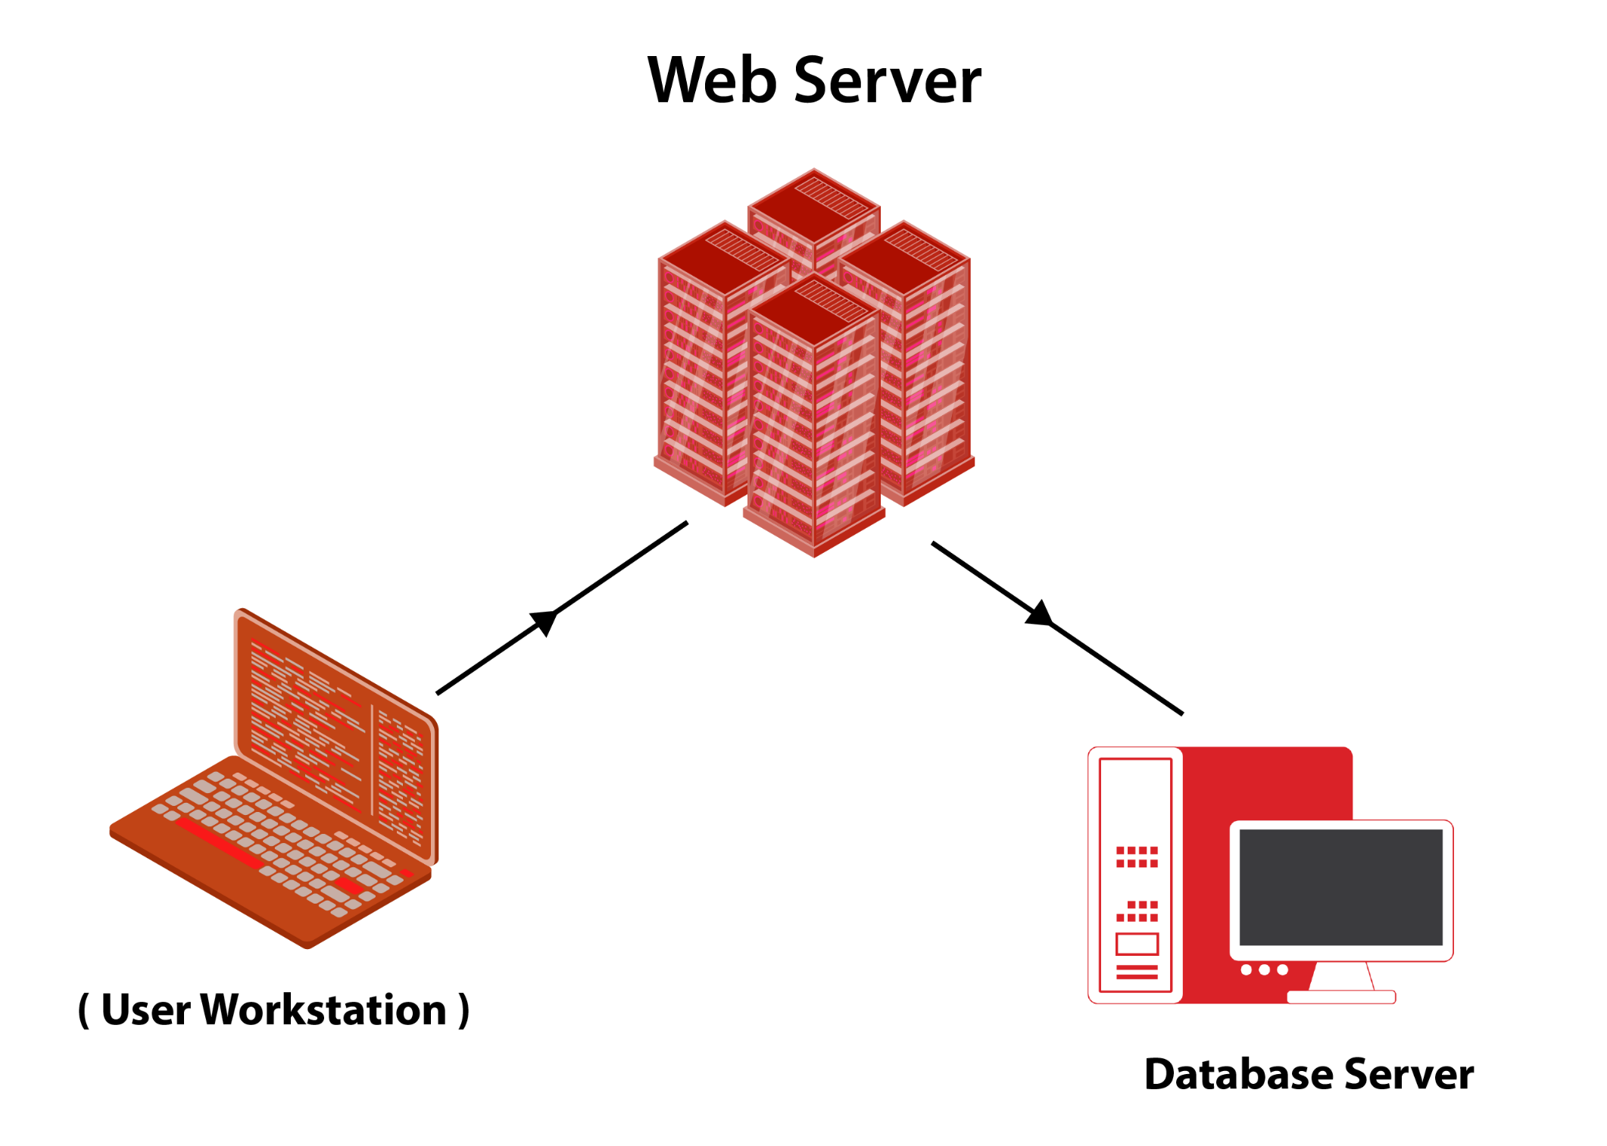
Kerberos Delegation
Kerberos Delegation allows end-user credentials reuse in multi-tier application where Kerberos double hop is required.
Example -

Slide 11
Kerberos Delegation
A user provides credentials to the Domain Controller. (AS_REQ)
The DC returns a TGT. (AS_REP)
The user requests a TGS for the web service on Web Server. (TGS_REQ)
The DC provides a TGS. (TGS_REP)
The user sends the TGT and TGS to the web server.
The web server service account use the user's TGT to request a TGS for the database server from the DC.
The web server service account connects to the database server as the user.

Slide 12
Kerberos Delegation
Delegation is of two types:
Unconstrained – access to any service on any Computer in the domain.
Constrained – access to specified services to specified computer.

Slide 13
Kerberos Unconstrained Delegation
Windows Server 2000 introduced Unconstrained Delegation
If Unconstrained Delegation is enabled, the DC places user's TGT inside TGS. When presented to the server with unconstrained delegation, the TGT is extracted from TGS and stored in LSASS.
Escalate privileges to Domain Admin in case we compromise an account with Unconstrained Delegation.

Slide 14
Kerberos Unconstrained Delegation
Scenario 1: Sensitive User authenticates to the machine with KUD.
Scenario 2: KUD + PrinterBug (Very Popular – Will be added soon in the lab)

Slide 15
Kerberos Constrained Delegation
Windows Server 2003 Microsoft introduced a new type of delegation.
Constrained Delegation, is a more secure form of delegation that restricts the services to which a service can delegate authentication. It provides more granular control over delegation permissions. The server with constrained delegation can no longer cache the TGTs.
Protocol Transition - user authenticates to a web service without using Kerberos and the web service makes requests to a database server to fetch results based on the user's authorization.
Escalate to Domain Admin user by impersonating them in case we compromise an account or a computer with KCD.

Slide 16
Kerberos Constrained Delegation
To impersonate the user, Service for User (S4U) extension is used which provides two extensions:
Service for User to Self (S4U2self) - Allows a service to obtain a forwardable TGS to itself on behalf of a user. The service account must have the T2A4D UserAccountControl attribute TRUSTED_TO_AUTHENTICATE_FOR_DELEGATION set.
Service for User to Proxy (S4U2proxy) - Allows a service to obtain a TGS to a second service on behalf of a user. This is controlled by msDS-AllowedToDelegateTo attribute. This attribute contains a list of SPNs to which the user tokens can be forwarded.

Slide 17
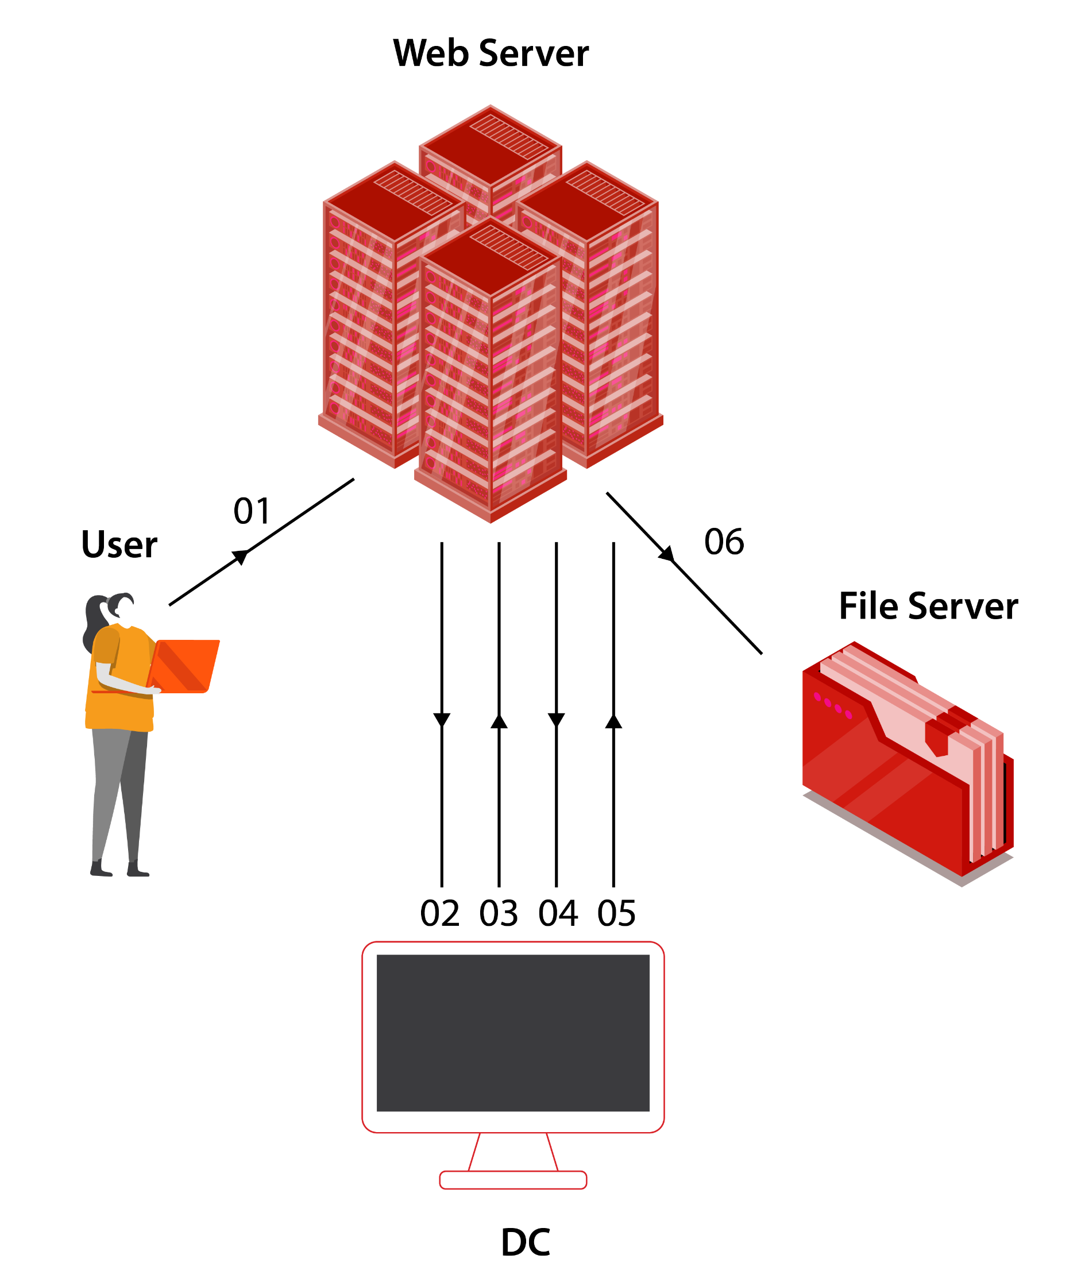
Kerberos Constrained Delegation
A user, authenticates to the web service (running with service account prod_svc) using a non-Kerberos compatible authentication mechanism.
The web service requests a ticket from the Key Distribution Center (KDC) for user's account without supplying a password, as the prod_svc account.
The KDC checks the prod_svc userAccountControl value for the TRUSTED_TO_AUTHENTICATE_FOR_DELEGATION attribute, and that user's account is not blocked for delegation (not a protected user). If OK it returns a forwardable ticket for user's account (S4U2Self).
The service then passes this ticket back to the KDC and requests a service ticket for the CIFS/dc01 service.
The KDC checks the msDS-AllowedToDelegateTo field on the prod_svc account. If the service is listed, it will return a service ticket for dc01.red.local (S4U2Proxy).
The web service can now authenticate to the CIFS on dc01.red.local as user using the supplied TGS.

Slide 18
Kerberos Constrained Delegation
Scenario 1: Command Execution as user with KCD Permissions. Use the Rubeus tgtdeleg command to get a usable TGT for the current user
Scenario 2: Use the KCD user hashes or plaintext password.
Since the SPNs are not encrypted we can use the /altservice parameter as well

Slide 19
Resource Based Constrained Delegation
Resource-Based Constrained Delegation (RBCD) is a feature that was introduced starting with Windows Server 2012.
In unconstrained and constrained Kerberos delegation, a computer/user is told what resources it can delegate authentications to. In resource-based Kerberos delegation, computers (resources) specify who they trust and who can delegate authentications to them.

Slide 20
Resource Based Constrained Delegation
Scenario 1: Compromised account allows impersonation of any user to any service on the host by leveraging msDS-AllowedToActOnBehalfOfOtherIdentity attribute.
Scenario 2: GenericWrite access on a computer account enables adding the compromised account to msDS-AllowedToActOnBehalfOfOtherIdentity, facilitating impersonation on the target host.
Scenario 3: Using mitm6 or Responder with ntlmrelayx, relayed NTLM credentials create a new computer account, and adding it to the computers msDS-AllowedToActOnBehalfOfOtherIdentity attribute whose credentials were relayed.

Slide 21

WEBINAR

Slide 22
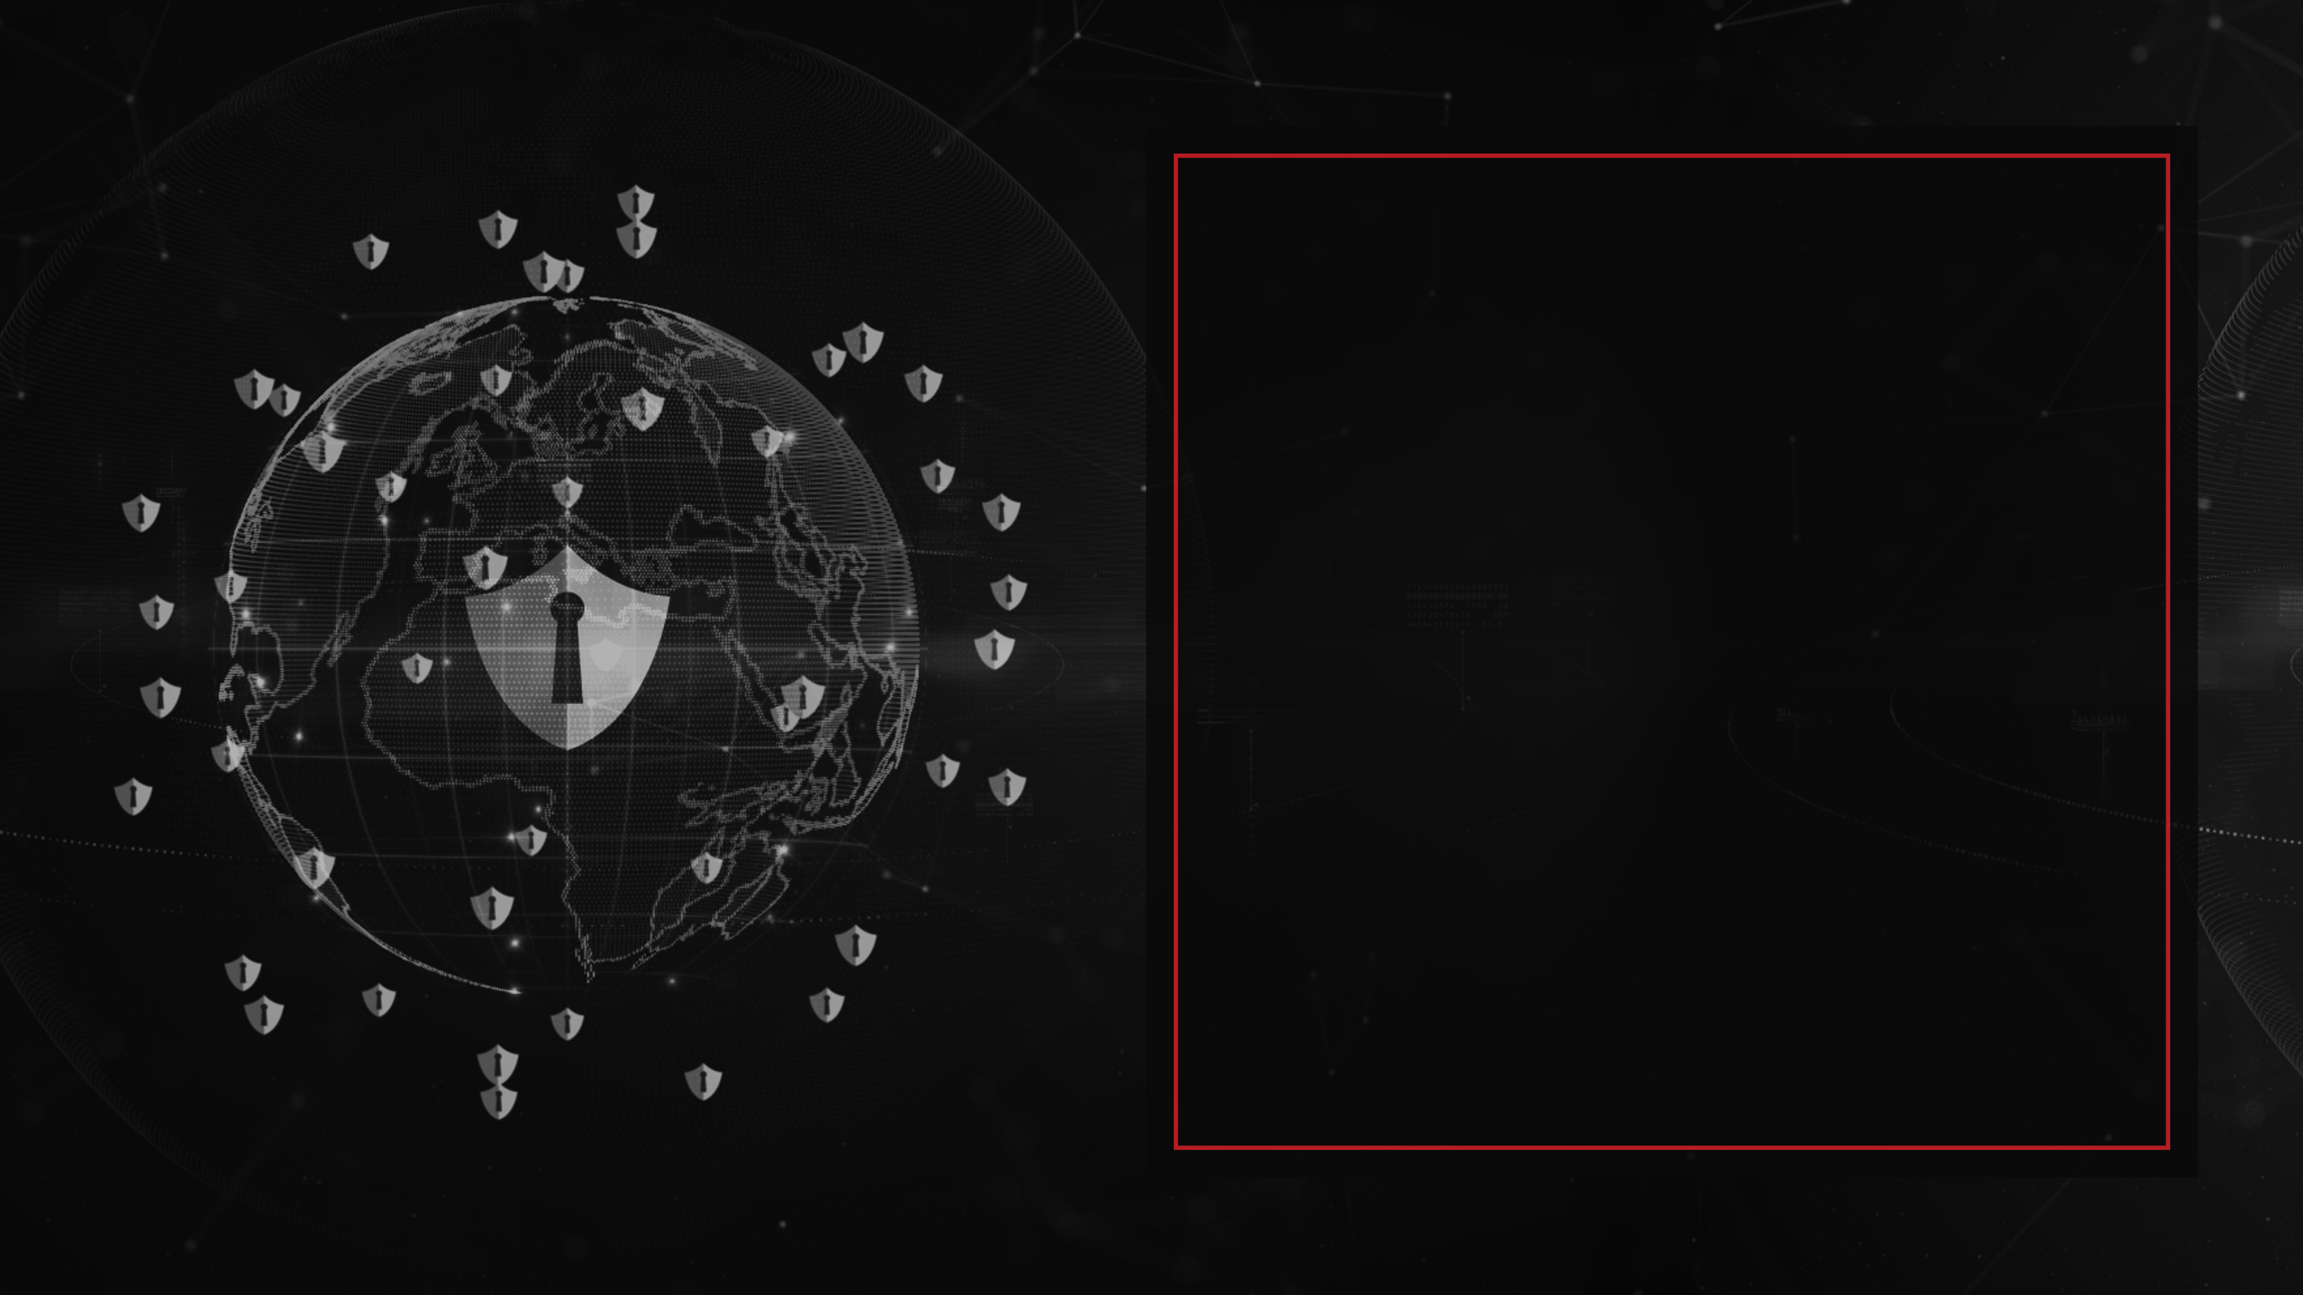






Securing the Future
REACH US
www.payatu.io
info@payatu.io
FOLLOW US

